Slide 1
Hand Hygiene in Healthcare Setting
.
Notes:
Hand Hygiene in Health-care Facilities
The importance of Proper Hand Hygiene for Health-care Workers

Slide 2
Objectives
By the end of this session, participants will be able to:
Describe the role hand hygiene (HH) plays in healthcare-associated infection (HAI) prevention
Define types of HH in healthcare settings
Describe the right time and procedure way for (HH)
Describe how to evaluate your (HH) Program
Describe strategies for improvement of HH practices
Notes:
Objectives:
Learn the role hand hygiene plays in HAI prevention
Learn the right time and right way for Hand Hygiene
Review the proper use of gloves to prevent germ transmission

Slide 3
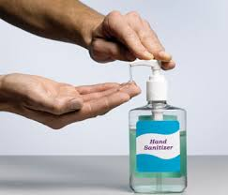
Hand Hygiene
Refers to washing hands with soap and running water or use of, Alcohol based hand rub, for the purpose of the removal of visible soil/dirt and the removal or killing of micro-organisms
OR
Notes:
The purpose of HH is to remove soil, organic material and transient microorganisms from the hands. HH does not eliminate the normal flora
Hand hygiene is a general term that applies to either handwashing, alcohol-based handrub, or
surgical hand hygiene

Slide 4
Introduction
When not clean, healthcare workers hands are the main route of cross-transmission of potentially harmful pathogens
Scientists estimate that up to 80% of all healthcare associated infections are transmitted by healthcare workers hands
Hand hygiene protects the patient against harmful pathogens carried on healthcare worker’s hands or present on his/her own skin
Hand hygiene protects HCWs and the healthcare environment from harmful pathogens
Adherence to recommended hand hygiene practices will promote patient safety and prevent infections
Notes:
Hands and Infection Transmission:
A health care workers hand when not clean is the main route of cross-transmission of potentially harmful germs between patients in a health care facility.

Slide 5
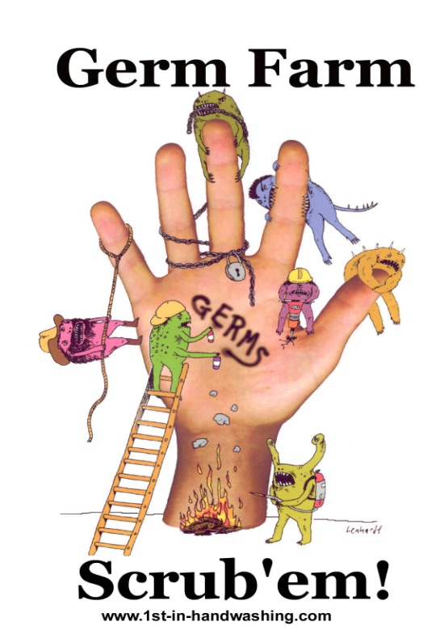

Lack of Hand Hygiene + Patient Care = Increased Risks
Increased risk for:
Hand contamination
Potential risk to patient safety
Notes:
Lack of Hand Hygiene + patient care = Increases risks
Health care workers hands become progressively colonized with microorganisms and with potential pathogens during patient care. The absence of hand hygiene and the longer the duration of care given to the patient increases the risk of hand contamination and potential risks to patient safety

Slide 6
Increased Compliance with Hand Hygiene Means …
Reduced number of patients acquiring HAI’s
Decreased wastage of resources
Saving lives
Notes:
Something as simple as good hand hygiene can reduce the number of patients acquiring HAI, and decrease the waste of resources and ultimately save lives.

Slide 7
Types of Hand Hygiene Procedures
Routine hand washing
Alcohol based hand rub (ABHR)
Surgical hand scrub
Notes:
Handwashing refers to washing hands with plain soap and water. Handwashing with soap and water remains a sensible strategy for hand hygiene in non-healthcare settings and is recommended by CDC and other experts.
• Alcohol-based handrub refers to the alcohol-containing preparation applied to the hands to reduce the number of viable microorganisms.

Slide 8
ABHR
Alcohol-based gels, sprays, and solutions
Kills 99% of microorganisms
Takes 15-30 seconds to dry
Quicker and easier to perform
To be effective, an adequate amount (5 ml) solution should be used

Slide 9
ABHR (cont.)
Gives a greater initial reduction in hand flora
Will help prevent this growth of microorganisms for a period of time
Contain a small amount of an emollient such as glycerin, propylene glycol or sorbitol that protects and softens skin
Should not be used when hands are visibly soiled. Instead hand wash with soap and water

Slide 10
Surgical Hand Scrub
Must be performed preoperatively by surgical personnel before performing any surgical procedure
Scrub for 2-3 minutes including the wrists & fore-arms
Clean finger nails
Sterile single use towels are used to dry the hands thoroughly

Slide 11
Key Terms
The patient zone - includes the patient, surfaces and items that are temporarily and exclusively dedicated to him/her
The health care area - all surfaces in the health care setting outside of the patient zone
Notes:
Key Terms
The patient zone- includes the patient, surfaces and items that are temporarily and exclusively dedicated to him/her
The Health care area- all surfaces in the health care setting outside of the patient zone

Slide 12
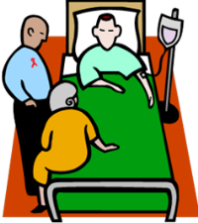
The Patient Zone
The patient zone refers to the following:
The patient
Immediate surroundings - surfaces that are touched by or in direct physical contact with the patient
  Bed rails
  Bedside tables
  Bed linens
  Tubing
  Medical equipment
Notes:
The patient zone
The patient zone contains:
Patient X
Immediate surroundings - surfaces that are touch by or in direct physical contact with the patient
-Bed rails
-Bedside tables
-Bed linens
-Tubing
-Medical equipment

Slide 13
The Healthcare Area
Refers to everything outside of the patient zone
HH while caring for patients helps to protect the wider health care environment from contamination by patients germs
Notes:
The Health-care Area
Is everything outside of the patient zone:
Hand hygiene while caring for patients helps to protect the wider health care environment from contamination by patients germs

Slide 14
Hand Hygiene
Right time
Right way
Right technique
Notes:
It is just a matter of performing this simple task at the right time and in the right way.

Slide 15
Right Time
To avoid prolonged hand contamination…
Perform hand hygiene when indicated!
Notes:
Right Time
To avoid prolonged hand contamination, it is important to perform hand hygiene when indicated

Slide 16
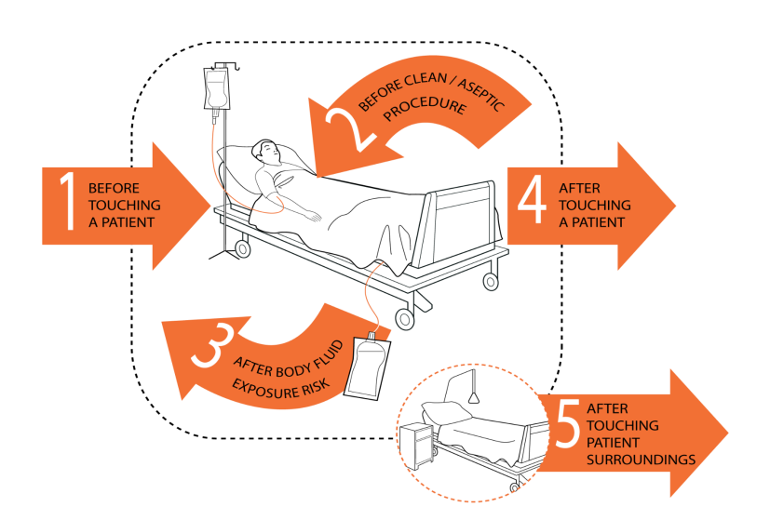
Your 5-Moments For
Hand Hygiene
Notes:
The five moments approach making it easier to
understand
remember
practice
the hand hygiene indications at the point of care

Slide 17
Moment 1: Before Touching a Patient
Clean your hands before touching a patient when approaching him/her
Why?
To protect the patient against harmful germs carried on your hands

Slide 18
Moment 2: Before a
Clean /Aseptic Procedure
Clean your hands immediately before accessing a critical site with infectious risk for the patient
Why?
To protect the patient against harmful germs, including the patient’s own, entering his/her body

Slide 19
Moment 3: After Body Fluid Exposure Risk
Clean your hands after touching any object or furniture in the patient’s immediate surroundings, when leaving without having touched the patient
Why?
To protect yourself and the health-care environment against germ spread

Slide 20
Moment 4: After Touching a Patient
Clean your hands as soon as a task involving exposure risk to body fluids has ended (and after glove removal)
Why?
To protect yourself and the health-care environment from harmful germs

Slide 21
Moment 5: After Touching
Patient’s Surrounding
Clean your hands when leaving the patient’s side, after touching a patient and his/her immediate surroundings
Why?
To protect yourself and the health-care environment from harmful germs

Slide 22
Right Way
To avoid prolonged hand contamination:
Use the appropriate technique
Use an adequate quantity
Use for recommended length of time
Notes:
How to Wash Hand / Use hand rubs properly
To avoid prolonged hand contamination, it is not only important to perform hand hygiene when indicated, but also to use the appropriate technique and an adequate quantity of the product to cover all skin surfaces for the recommended length of time.
(Excersie Hand gel practice)

Slide 23
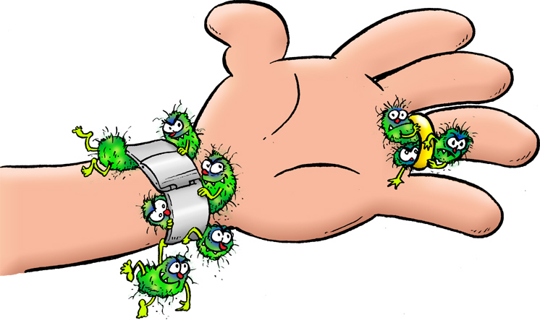
Three elements are essential for effective hand washing.
Soap Running water/ABHR
Friction
Timing (hand washing 40–60 sec. & ABHR-15–30 sec)
Technique

Slide 24
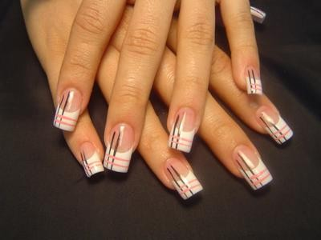
Steps In Hand Washing
Keep nails short (not more than ¼ inch) and avoid artificial nails
Remove jacket and roll sleeves back
Remove watches & rings
24

Slide 25
Cont. Steps In Hand Washing
Use running water to wet hands
Use soap
Use friction, remove debris.
Use clean single use towels for hand drying (disposable paper towel )

Slide 26
TIMING (the standard acceptable length of time for hand washing
Hand washing(40–60 sec): wet hands and apply soap; rub all surfaces; rinse hands and dry thoroughly with a single use towel.
Hand rubbing (15–30 sec): apply enough product to cover all areas of the hands; rub hands until dry.

Slide 27
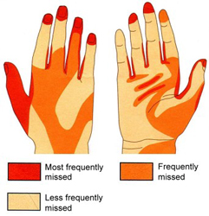
27

Slide 28
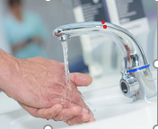
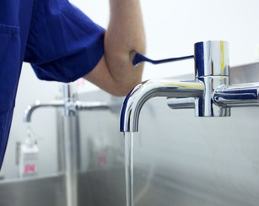
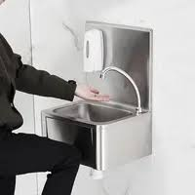
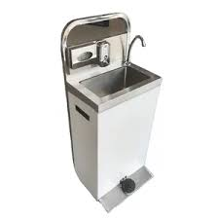
Types of hand washing taps.
Elbow operated
Foot operated
Sensor operated
Knee Operated
Hand-operated taps use disposable paper towel to turn off the tap.
Sensor operated
Elbow operated
Knee operated

Slide 29
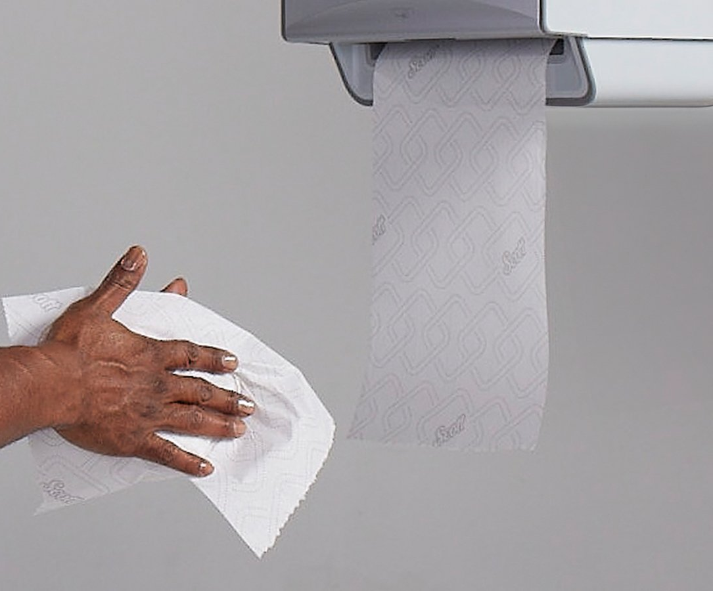
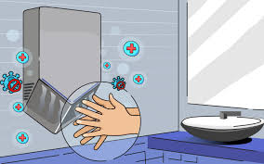
Hand drying after washing.
Use disposable paper towel
Use sterile single use towel
or air dry them.
Hand dryers are not recommended in Health Care settings.
Avoid using common towel
Use disposable hand paper towels
Avoid Hand dryers in healthcare settings

Slide 30

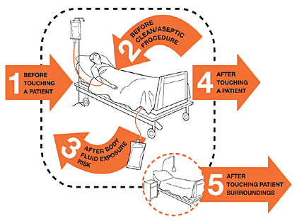
Remember
HH must be performed at the point of care
There are five moments when it is essential that you perform HH
  Before patient contact
  Before clean procedures
  After body fluid exposure risk
  After touching patient
  After touching patient surroundings
Always adhere to specific HH for isolation precautions (e.g., soap and water for C.diff)

Slide 31
Remember
It is essential that everyone performs hand hygiene using the appropriate technique and time duration in order for it to be effective.

Slide 32
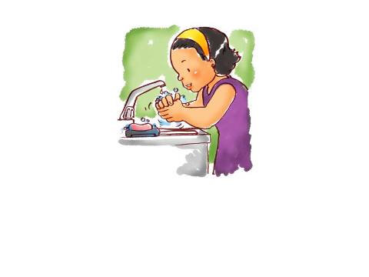
Let’s Practice!!!
Notes:
Demonstrate step by step how to hand rub and ask the audience to participate

Slide 33
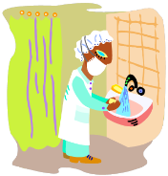
Safeguard in hand hygiene
Gloves, Nails and Skin Care
Gloves do not replace the practice of optimal hand hygiene
Avoid hand washing immediately before or after using an ABHR
Avoid hot water
Let hands dry completely before putting on gloves
Use hand lotions and creams
Allergies or adverse reactions – use alternative products
No artificial fingernails or extenders
Keep natural nails short (0.5 cm)
Remove jewelry
Notes:
Gloves DO NOT take the place of hand hygiene
Glove use neither alters nor replaces the performance of hand hygiene
Gloves should be removed and hand hygiene performed when indicated by the 5 moments of hand hygiene and clean gloves put back on
Nail length is important because even after careful handwashing, HCWs often harbor substantial numbers of potential pathogens in the subungual spaces.
Numerous studies have documented that subungual areas of the hand harbor high concentrations of bacteria, most frequently coagulase-negative staphylococci, gram-negative rods (including Pseudomonas spp.), corynebacteria, and yeasts.
Natural nail tips should be kept to o.5 cm in length.
A growing body of evidence suggests that wearing artificial nails may contribute to transmission of certain healthcare-associated pathogens. Healthcare workers who wear artificial nails are more likely to harbor gram-negative pathogens on their fingertips than are those who have natural nails, both before and after handwashing. Therefore, artificial nails should not be worn when having direct contact with high risk patients.

Slide 34

Evaluating Your Hand Hygiene Program
Why is it important?
Measurement of the effectiveness of current practices
Identifying areas needing increased education
To be able to give feedback to employees on their performance
Notes:
Why it is important…
Measurement of the effectiveness of current practices
Identifying areas needing increased education
To be able to give feedback to employees on their performance

Slide 35
How to Observe Hand Hygiene
Direct observation is the most accurate method
Observer must conduct the observation without interfering with ongoing work
Observer should be familiar with “The 5 Moments for Hand Hygiene” and the data collection tool that is being utilized
Identify opportunities for hand hygiene
Record if the worker performed hand hygiene at the right time
Notes:
The first step in evaluating your HH program is by performing observational studies of persons performing HH.
Direct observation is the most accurate method
Observer must conduct the observation without interfering with ongoing work
Observer should be familiar with “The 5 Moments for Hand Hygiene” and the data collection tool that is being utilized
Identify opportunities for hand hygiene and then record if the worker being observed performed hand hygiene at that time

Slide 36
Calculating Compliance Rates
Total number of times hand hygiene was performed correctly
Total opportunities for hand hygiene
Multiply by 100
Notes:
Using the data collected, a hand hygiene compliance rate can be calculated using this formula. This sounds complicated but hopefully it will make sense when we apply it to our sample. You will add all the times that hand hygiene was performed at the appropriate times during the observation for all persons observed. Next add the total number of moments available for hand hygiene that were observed for all persons. Divide the number times HH was performed by the number of moments for HH. Then multiply the number by 100 to get a percentage rate.

Slide 37
Example for Calculating Compliance Rates
Total number of times hand hygiene was performed
(4)
_______________________________________
Total opportunities for hand hygiene
(6)
4/6 = 0.667
0.667 x 100= 66.7%
Notes:
Plugging these numbers into out formula: Total number of times HH was performed 4; Total opportunities for HH 6.
4 divided by 6= 0.667
Multiply by 100 to get a percentage and you get 66.7%
So for this sample, the compliance rate would be 66.7% This observation should be done regularly and the results tracked. An increase in the percentage would indicate that the education being done is having a positive effect. A decrease in the number would indicate the need for additional training on HH.

Slide 38
Feedback to Staff
Why is it important?
  Helps them recognize gaps in good practices and knowledge
  Can help raise awareness and can convince them there is a problem
  Ongoing feedback will demonstrate improvement and sustain motivation
Notes:
You can also use the observational tool to look for areas to focus your educational program and reminders for the staff. In the sample tool we used to calculate compliance rates, you can see that HH was not completed prior to touching a patient and after touching surroundings. If there are areas such as these that commonly missed by staff during observations, they should be reinforced during education.
Providing feedback to staff on the results of the observational studies and compliance rates is an important part of the evaluation process.
Helps them recognize gaps in good practices and knowledge
Can help raise awareness and can convince them there is a problem
Ongoing feedback will demonstrate improvement and sustain motivation

Slide 39
THE POWER TO PREVENT & CONTROL INFECTIONS IS IN OUR HANDS
Clean Hands Save Lives
39

Slide 40

Thank You
Any Questions
Notes:
ASK participants if they have any questions. ADDRESS any questions in the Parking Lot.
THANK participants for their attention during this session and indicate the next session or break.

