Slide 1
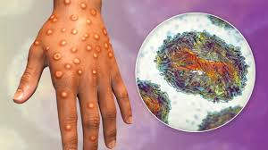
MPOX- WHAT YOU NEED TO KNOW
FROM
INFECTION CONTROL NURSES CHAPTER.
.

Slide 2
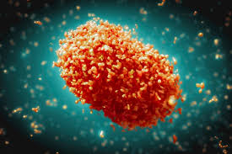
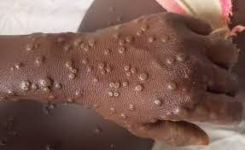
MPOX HISTORY
Mpox is a viral zoonotic disease previously called monkey pox
First identified in tropical rainforest areas of Central and West Africa and with time it spread to other regions.
It was first identified in Denmark in monkeys kept for research in 1958.
The first reported human case was a nine month old boy from DRC in 1970
Worldwide outbreak affected 18,788 since 1970 to 2019.
The current outbreak upsurge from 2022 has has affected more than 116 countries with Kenya included.

Slide 3
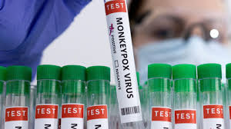
THE PATHOGEN
An enveloped double stranded DNA virus
There two clades of monkey pox virus
Clade 1
Endemic in Central Africa or Congo Basin
More virulent and associated with large outbreaks
Case fatality rate around 10% (CDC 2024)
Clade II
Endemic in West Africa
Low case fatality rate around 3.6% (CDC 2024)

Slide 4
WHO Mpox outbreak case definition
A Suspected -A person who is a contact of a probable or confirmed Mpox case in the 21 days before the onset of signs or symptoms.
A Probable- A person presenting with an unexplained acute skin rash, mucosal lesions or lymphadenopathy and link to a probable or confirmed case of Mpox in the 21 days before symptom onset
Confirmed -A person with laboratory confirmed MPXV infection by detection of unique sequences of viral DNA by real-time polymerase chain reaction (PCR) and/or sequencing.

Slide 5
Defining mpox outbreaks
A suspected outbreak
the occurrence of one or more probable case of mpox in a nationally or locally defined geographic area, regardless of the origin of the case or cases.
A confirmed outbreak
the occurrence of one or more laboratory confirmed cases of mpox in a nationally or locally defined geographic area regardless of the origin of the case

Slide 6
How is Mpox Transmitted?
Mpox spreads through direct contact with infected skin, scabs ,body fluid , blood, or wounds
Indirect contact with contaminated materials e.g. bed linen, cloth, contaminated surfaces
Contact with respiratory droplets during prolonged close face to face with an infected person.
Pregnant mother can spread the virus to the foetus through the placenta
Though sexual intercourse with an infected person/sex toys
Animal-to-human transmission through bites, scratches, or direct contact with blood, body fluids, or wounds of an infected animal

Slide 7
Signs and symptoms of Mpox
The incubation period is roughly 1-3 weeks.
Mpox symptoms last 2 to 4 weeks and may include:
Skin rash (this is the most noticeable sign)
Fever
Headache
Sore Throat
Swollen lymph nodes.
Body aches and backpains
Tiredness.
NB. Mpox symptoms may last longer for individuals with weakened immune system.

Slide 8
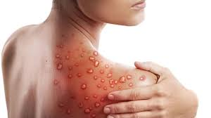
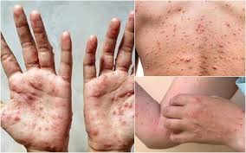
Mpox rash characteristic
These can appear anywhere on the body such as the:
Face, Mouth and Throat
Palms of hands and soles of feet
Groin and genital areas
Anus.

Slide 9
Mpox rash characteristic Stages
Stage 1: Macules appear like flat round pink spots with no bump, lasting for 1-2 days.
Stage 2: Papules go from a flat, pink spot to a raised bump ,lasts for 1- 2 days.
Stage 3: Vesicles-The bumps go from raised to filled with a clear fluid for 1-2 days.
Stage 4: Pustules-Vesicles progress from a clear fluid-filled bump to enlarged an opaque pus bump with a small divot in the center, this stage takes about a week.
Stage 5: Scabs-last over a week or two, the pus bumps will crust and scab over. Scabs will remain for about a week before beginning to fall off.

Slide 10
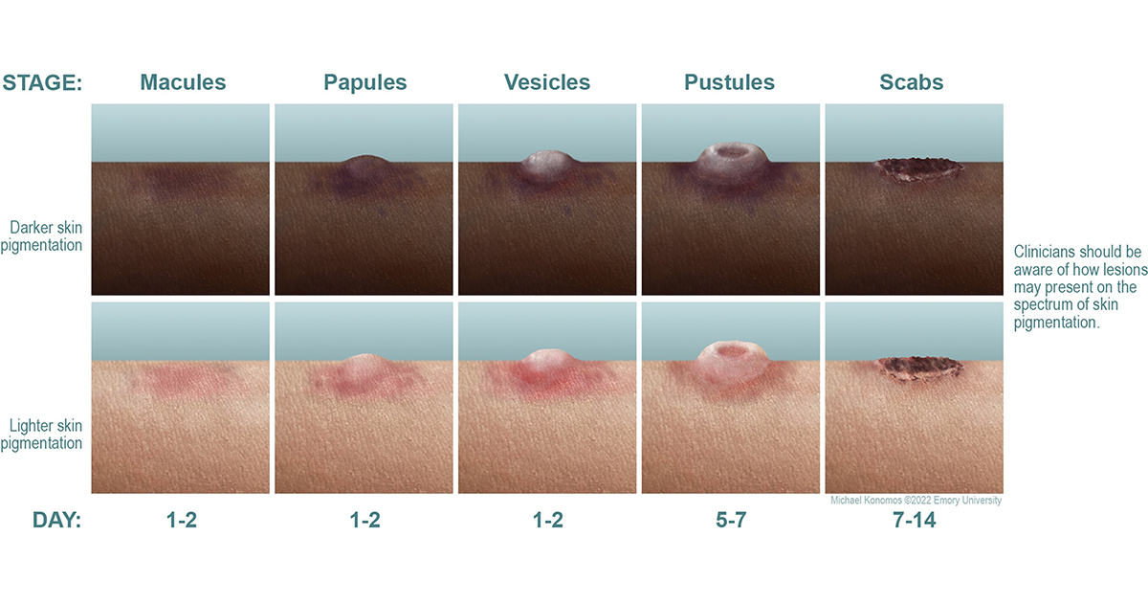
Mpox Characteristic rash
This is how the lesions may present on the spectrum of the skin pigment

Slide 11
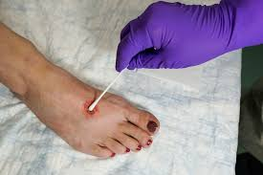
Diagnosis
Mpox can only be confirmed via polymerase chain reaction (PCR) and preferred sample being a skin lesion swab.
The best diagnostic specimens are taken directly from the rash – skin, fluid or crusts
In the absence of skin lesions, testing can be done on oropharyngeal, anal or rectal swabs.
Testing blood is not recommended.
Notes:
Testing blood is not recommended.
Antibody detection methods may not be useful as they do not distinguish between different Orthopox viruses.

Slide 12
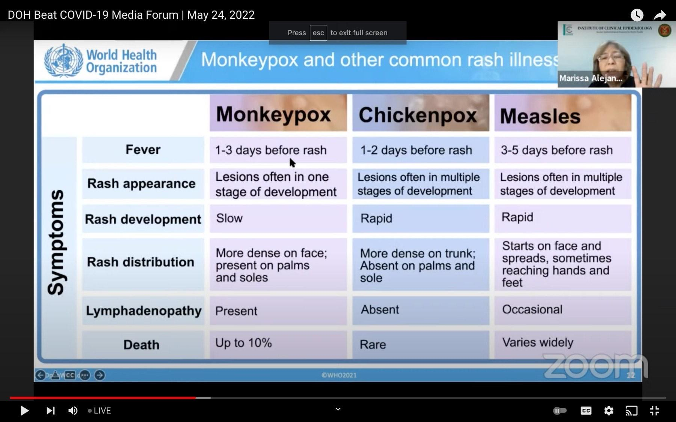
.

Slide 13
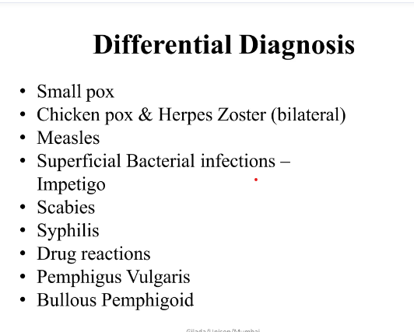
.

Slide 14
Who is at higher risks of contracting Mpox
Those who come close to patients with Mpox such as healthcare workers
Children
Pregnant Mothers
People with low immune system
Those who travel frequently into Mpox endemic areas
People living with infected individuals or Close contacts with Mpox patients
People with multiple sexual partners
NB. Any one can get Mpox if you do not adhere to preventive measures

Slide 15
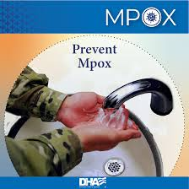
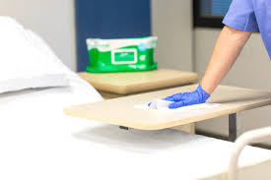
Prevention of transmission
Isolate the patient
Implement contact and droplet precautions(surgical mask in close contact)
Hand hygiene following the five moments of hand hygiene with the right technique
Effective environmental cleaning and disinfection

Slide 16
Cont. Prevention of transmission
Proper containment and disposal of waste
Appropriate linen handling and processing
Avoid shaving rash.
Avoid braking the blisters
Wear long sleaved shirt/blouse
Appropriate treatment. (mainly symptomatic)
Vaccination

Slide 17
POSSIBLE COMPLICATIONS
Ocular infections
Neurologic complications
Myopericarditis
Complications associated with mucosal lesions
Complications from uncontrolled viral spread due to moderate or severe immunocompromise, particularly advanced HIV infection

Slide 18
REFERENCES
CDC Guidelines, April 2024 https://www.cdc.gov/poxvirus/mpox/about/index.html
WHO outbreak management https:/www.who.int/emergencies/outbreak
Preventing Transmission of Infectious Agents in Healthcare Settings: https://www.cdc.gov/infection-control/hcp/isolation-precautions/index.html July 2023.
Precautions to Prevent Transmission of Infectious Agents: https://www.cdc.gov/infection-control/hcp/isolation-precautions/precautions.html
National infection prevention and control guidelines for healthcare services in Kenya, November 2024 (MoH)
National guidelines on healthcare associated infections surveillance, 2024 Edition (MoH)

